Slide 1

DATA-ORIENTED APPROACH FOR THE PERFORMANCE OF SMART HOME ENERGY MANAGEMENT SYSTEM
Jewel Anns
U2262339
MSc Data Analytics

Slide 2

Motivation
Research
Industry Insights
Analysis using Data
‘SMART’ house – emerging as the spearhead of energy revolution.
Buildings - major sources of energy consumption and greenhouse gas emissions.
Energy Crisis – Save energy – Energy Optimization – Energy Management – Black gold
Address sustainability and combat the negative effects of climate change.

Slide 3
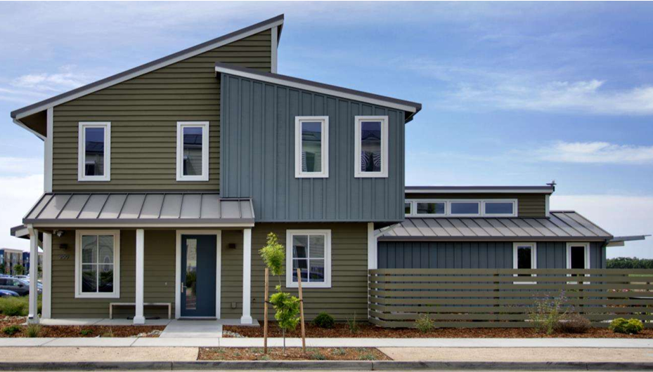
A smart, automated system designed to maximize domestic energy utilisation is called a Smart Home Energy Management System (SHEMS).
Goal - Increase energy efficiency, reduce total energy consumption and promote sustainability by utilising technologies and data-driven approaches.
Honda US Smart Home Project, Samsung SmartThings, Amazon Alexa Smart Home, Google Nest, Apple HomeKit.
Integrate computing and information technology to enhance the security, entertainment, comfort, and convenience of its residents.
Thermostats, Lighting, Security Systems, Cameras, Doorbells, Speakers and Displays
Introduction
Honda US Smart Home Project

Slide 4
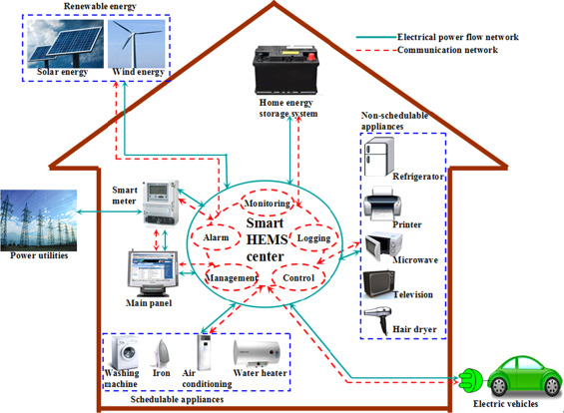
AIMS & OBJECTIVES
AIMS
- Optimization
Energy Consumption Forecasting
Efficiency Assessment
OBJECTIVES
Acquire and preprocess energy data from smart-home environment
Determination of important characteristics
Identification, selection and evaluation of models
Performing a comparative analysis
Smart Home Energy Management System

Slide 5

BACKGROUND
Need for optimal control to achieve significant power consumption reduction focusing on Heat Pump.
Need to analyze BDA for smart energy audits to enhance HVAC system efficiency and support accurate prediction.
Viable option for energy saving and peak electrical demand reduction.
Economical and ecologically responsible energy management by giving SHEMS data-driven decision-making capabilities.
Efficiency assessment

Slide 6

DATA DESCRIPTION
Honda US Smart Home Project
Duration: 2015 – 2022
Metrics: HVAC features
HVAC – 49 features
Granularity: Every day
Key Point: Forms the basis of energy consumption patterns in the Smart Home.

Slide 8


DATA PREPROCESSING
Data Cleaning
Data Visualisation
Identified missing values
Filling gaps using interpolation
Checking rows and columns
Employed matplotlib, seaborn, for initial data exploration.
Identified patterns and trends to understand the datasets.
Data Import
Data Formatting
Feature Selection and Data Splitting
Pandas to import
Narrowing down to HVAC features
Format conversion: Date columns formatted using pd.to_datetime().
Standardize the data.
Selected specific features.
Using this 80-20 split, a robust foundation was laid for model training and evaluation, ensuring reliable and validated results.

Slide 9

EDA (Exploratory data analysis)

Slide 10
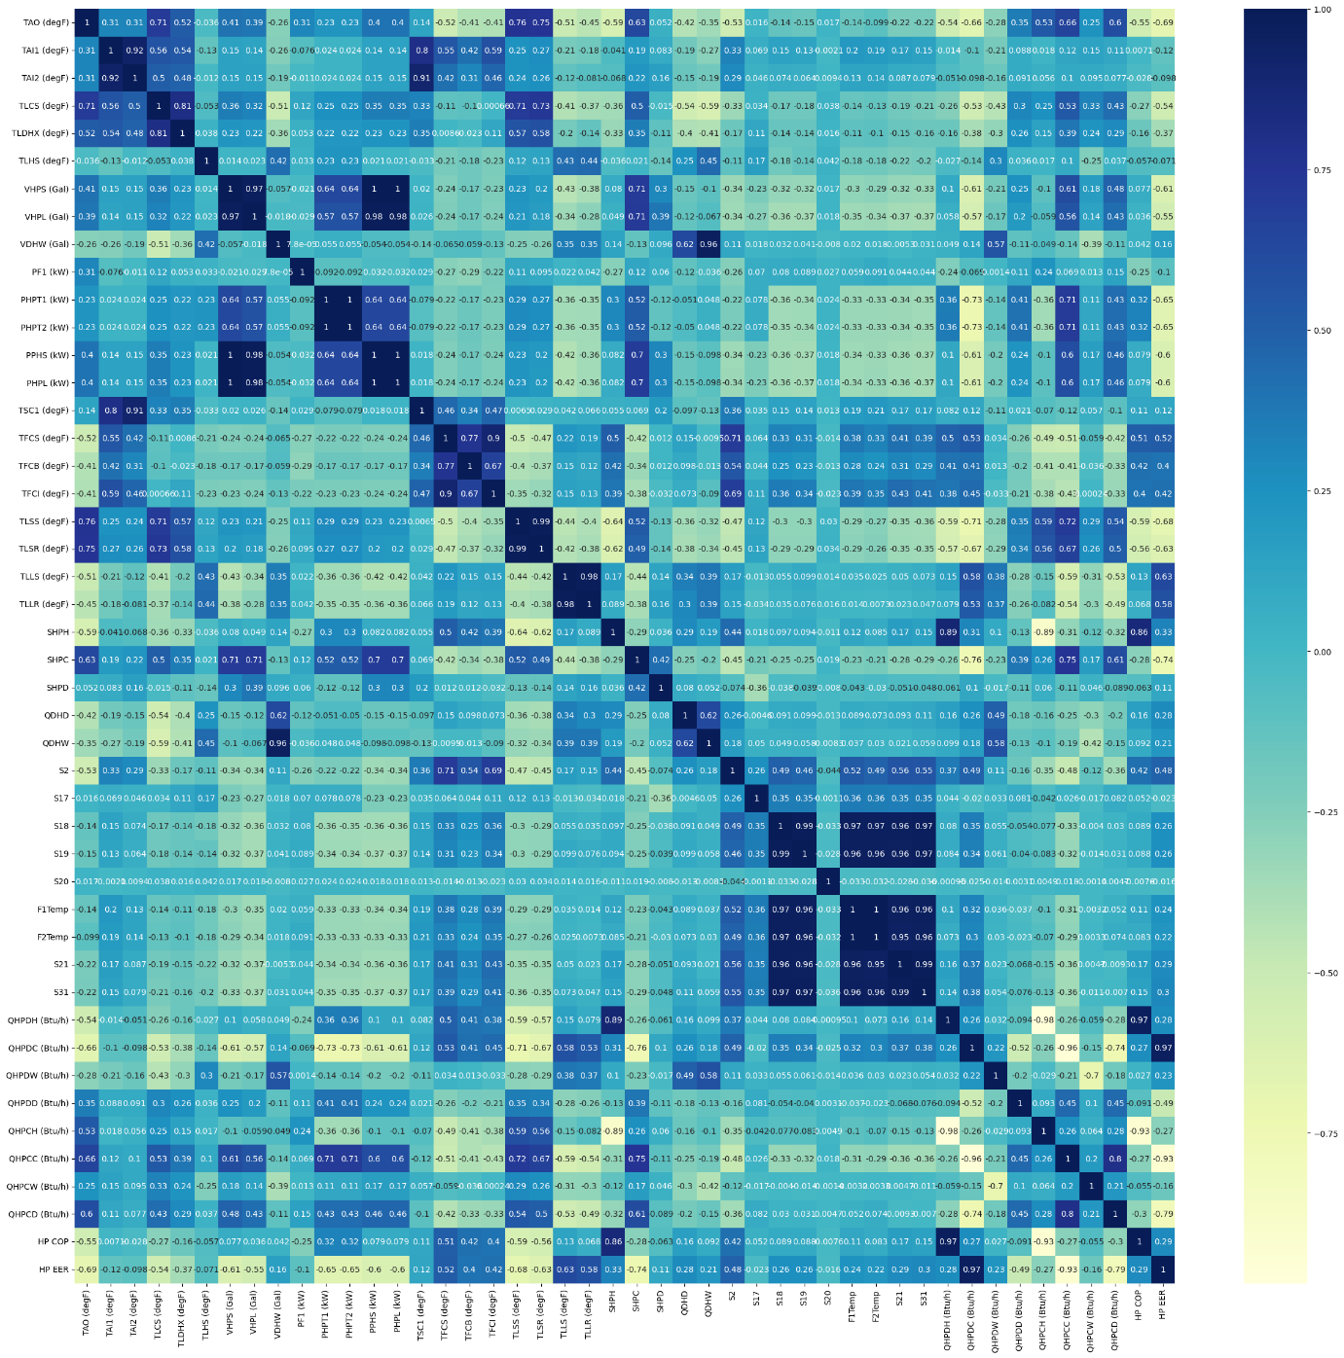
Correlation metrics
PHPT1 – Power, HVAC, Heat Pump Total power
Correlation with PHPT1
Feature Selection

Slide 11
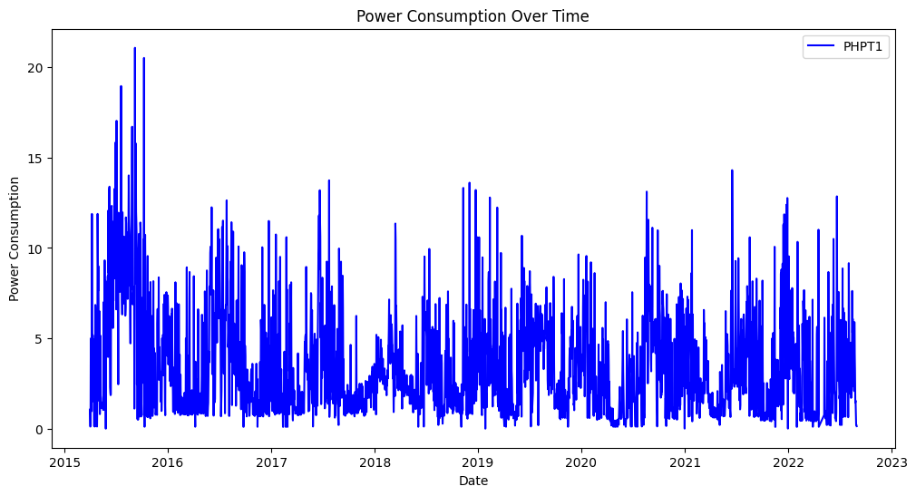
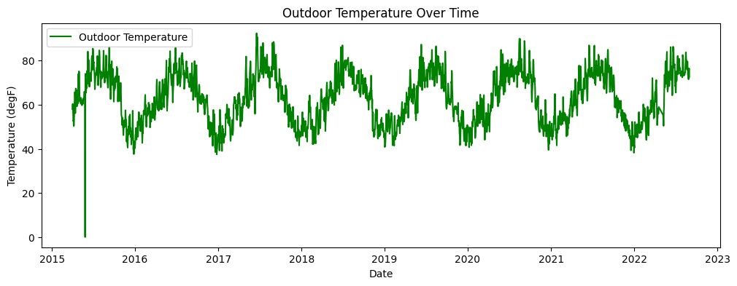
Plot of Power Consumption over time
Plot of Outdoor temperature over years

Slide 12

Energy consumption forecasting

Slide 13
ARIMA
LSTM
SVM
Hyperparameter selection using Grid Search
Model training and Predictive Performance
Forecasting
Hyperparameter configuration and model architecture
Model training
Evaluation on test data
Forecasting
Sequencing the data
Model training and Prediction
Forecasting

Slide 14
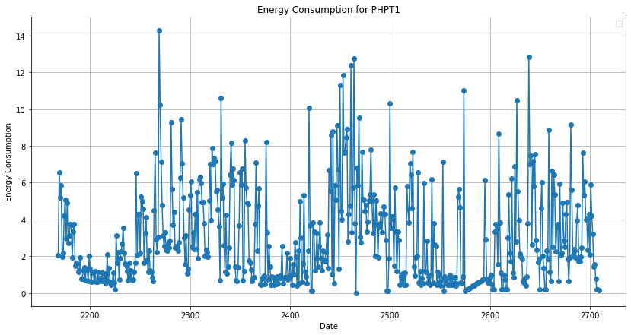
ARIMA
MAE: 2.19
MSE: 6.90
RMSE: 2.6262
While the model performed reasonably well in capturing overall consumption trends, the RMSE indicates some level of prediction error, maybe lack of capturing extreme values
Consumption Graph from ARIMA

Slide 15
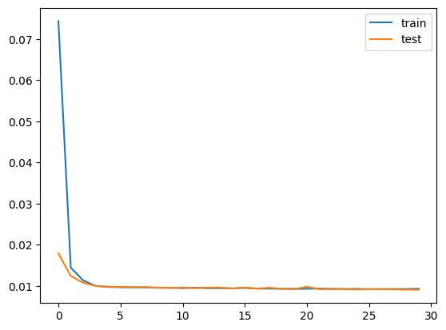
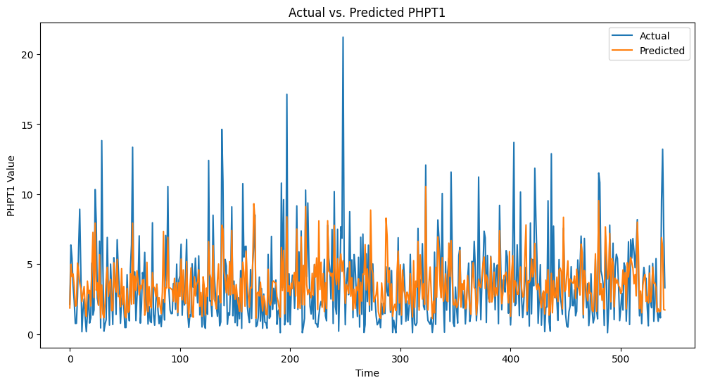
LSTM
RMSE: 2.0383
The comparatively lower RMSE suggests that the LSTM model excelled in capturing temporal dependencies, making it well-suited for forecasting in dynamic and evolving smart home environments
Predicted Value using LSTM

Slide 16
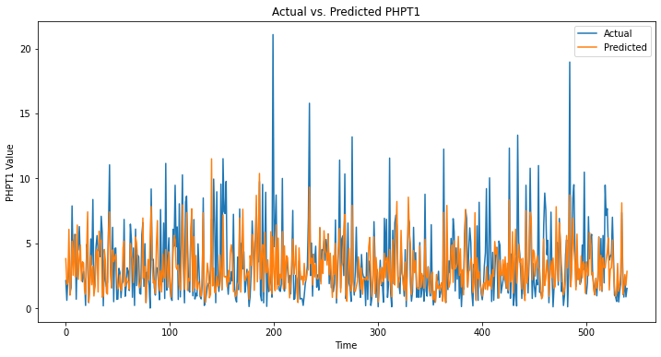
SVM
RMSE: 2.0575
SVMs, known for their versatility, provided a competitive performance in predicting energy consumption. The model's ability to handle non-linear relationships makes it a robust choice for capturing intricate patterns in smart home energy usage.
Predicted Value using SVM

Slide 17
Comparative study on energy consumption forecasting models
Comparative
Performance Metrics
Root Mean Squared Error (RMSE):
ARIMA: 2.6262
LSTM: 2.0383
SVM: 2.0575
Analyze complex energy consumption pattern
Better prediction result: RMSE
Non-linear and may exhibit distinct pattern.

Slide 18
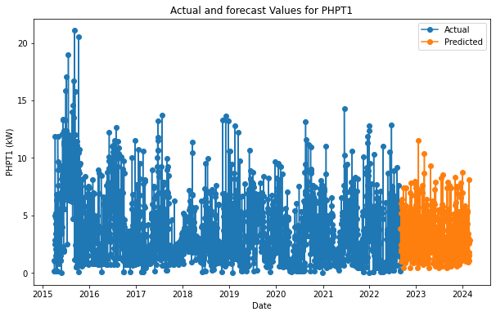
Energy consumption Forecasting
LSTM
Forecasting for 1 year
Identified the trends and patterns

Slide 19

Efficiency Assessment

Slide 20
FOR EACH MODEL
Model training
Predictive analysis
MULTIPLE LINEAR REGRESSION
RANDOM FOREST REGRESSOR
GRADIENT BOOSTING DECISION TREE
Assess the models' overall efficiency in optimizing energy usage within smart homes.
Assess their effectiveness in detecting notable features and interpretability.

Slide 21

Comparative study on efficiency assessment models

Slide 22
Performance Metrics
Root Mean Squared Error (RMSE) and R² value
• MLR: RMSE of 0.0074 and an R-squared of 0.99999.
• RF: RMSE of 0.0143 and an R-squared of 0.99998.
• GBDT: RMSE of 0.0345 and an R-squared of 0.99986.

Slide 23
Feature Importance
Power of circulating pump
Energy recovery
Flow rate
Status
Temperature

Slide 24
Comparative study on efficiency assessment models
Comparative Study
Optimization
Precision
Interpretability
Simplicity and high accuracy
Power consumption of circulating pump
Energy recovery – recovering and utilising waste heat
Flow rate – managing flow rate efficiency of the domestic hot water
Efficient adjustment of heating and cooling mode – by adjusting indoor temperature to outdoor temperature

Slide 25
FUTURE SCOPE
Incorporating other factors
Integration of Advanced ML models
Real-time adaptability
Collaborating with Utility Companies, Smart Grids and expanding areas
Other variables and other components that affect energy data
Experimenting with hybrid models
Other deep learning architecture
Automatically modify energy management according to real-time data, human behaviour, external influence
Co-ordinating with more general energy infrastructure objective

Slide 26
Conclusion
This study address the performance of the system by optimizing the energy which is a key aspect of energy management to state the efficiency of the system. The key resolution of the performance and assessment were addressed through necessary model selection and its execution.
Thus we can expand the study from small to large scale data to explore the canvas that each watt counts.

Slide 27

Thank you
u2262339@unimail.hud.ac.uk

